Slide 1
Parallelization of Catan
Nick Carter
Ryan Hartig

Slide 2
Introduction
Who are we?
What are we trying to do?
What is Catan?

Slide 3
Serial
An unlimited board with an unlimited number of players
Main source of computation: Board creation, Decision making

Slide 4
Parallel
Used OpenMP
MPI and CUDA are not well suited to our purposes
Initially we were going to go with a minmax search, but this proved too costly with an unlimited board size and player number
We use a greedy algorithm instead

Slide 5
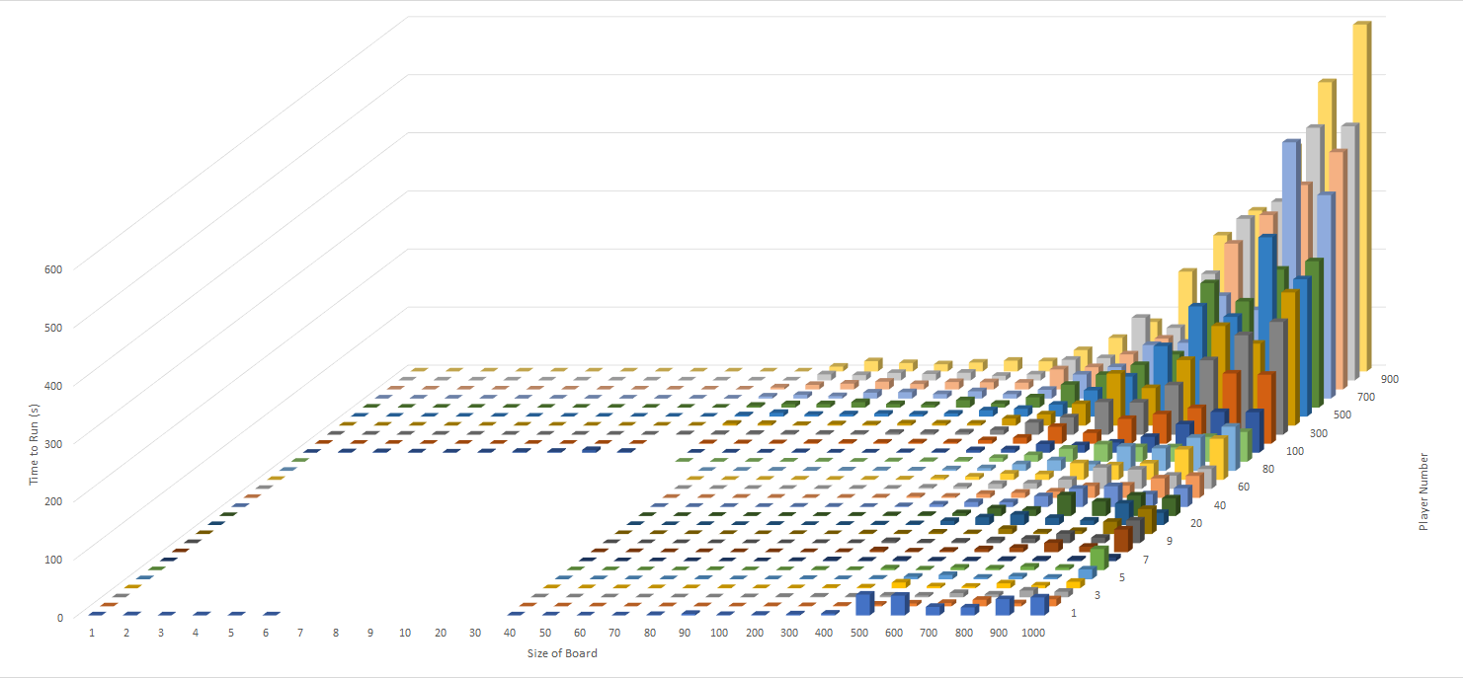
Results- Serial

Slide 6
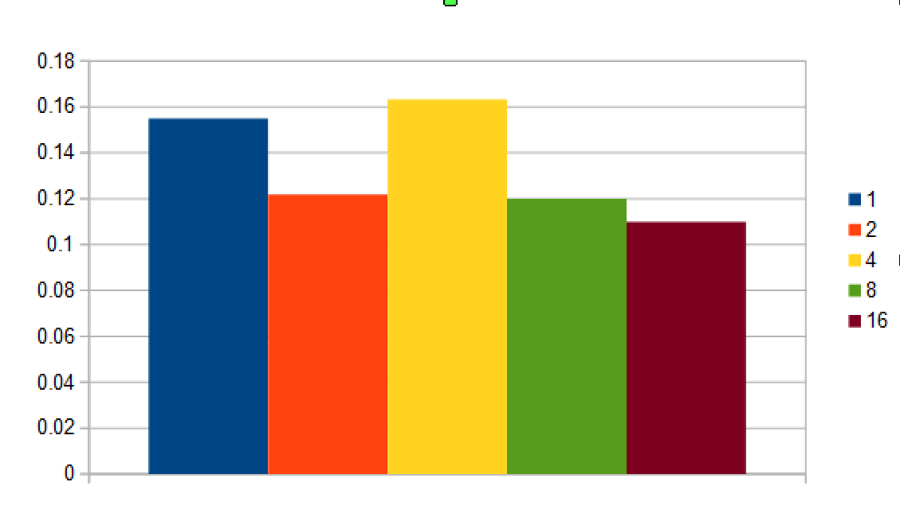
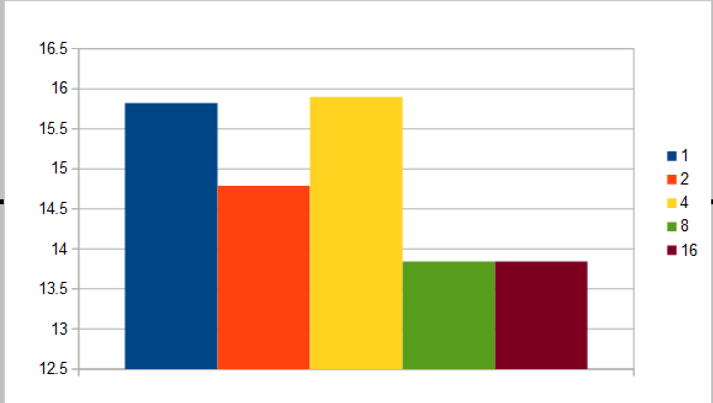
Results- Parallel
size=16, players=8 and vp=50
size=16 players=8 vp=5000

Slide 7
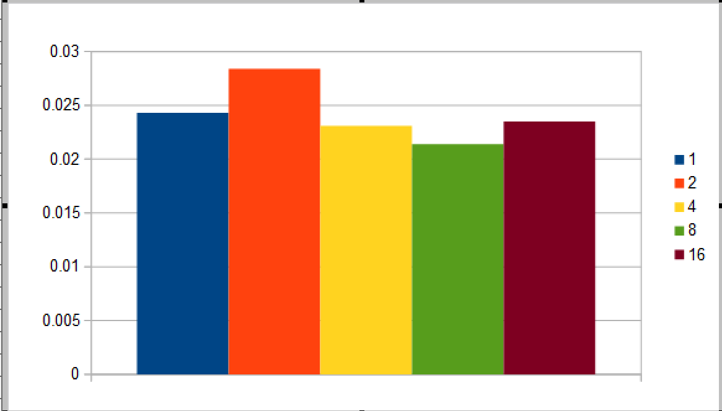
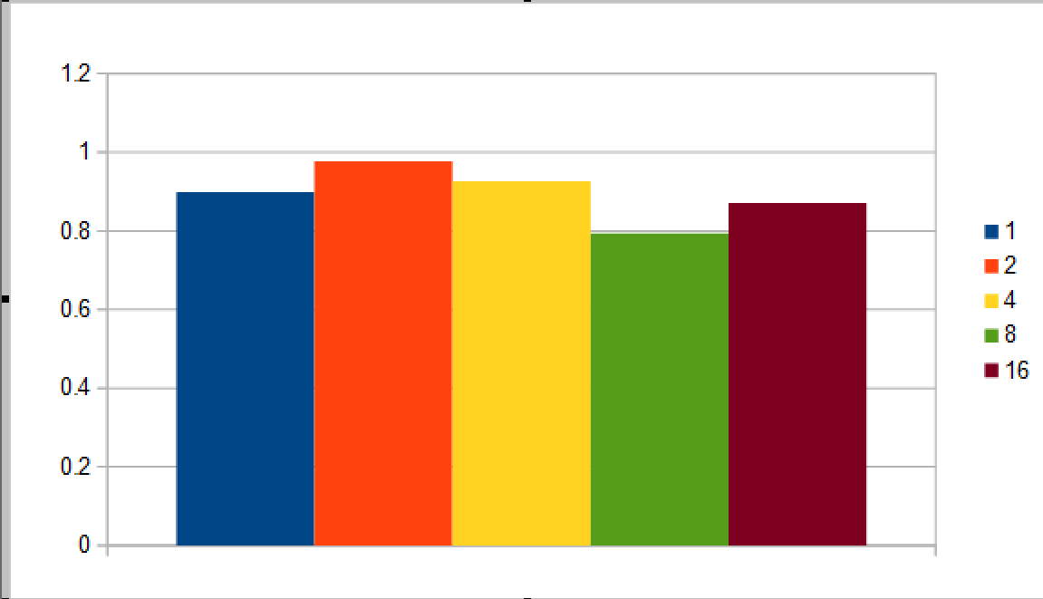
Results- Parallel 2
size=4, players=4 and vp=10
size=64 players=64 vp=10

Slide 8
Conclusion
What did we learn?
Namely, not everything needs to/can be parallelized
Future work
Improving the game
Improving the parallelization

